Slide 1
Lecture 9 Decidability (decision problems)
Decision problems,
universal language and
undecidable problems

Slide 2
Church-Turing thesis
=
Intuitive notion
of algorithm
Turing machine
algorithm
f is “continuous” at x0 = lim x x0 f(x)=f(x0)
An algorithm is a collection of instructions for
carrying out some task.

Slide 3
Descriptions of Turing machines
Formal description
Implementation description
Describe the way that the TM moves its head and the way that it stores data on its tape
High-level description
Describe an algorithm, and don’t need to mention how the machine manages its tape or head.

Slide 4
Enumerators
The language enumerated by a enumerator is the collection of all strings that it eventually prints out.
Printer
Control
0
1
0
Work tape
A language is Turing recognizable iff some enumerator enumerates it.

Slide 5
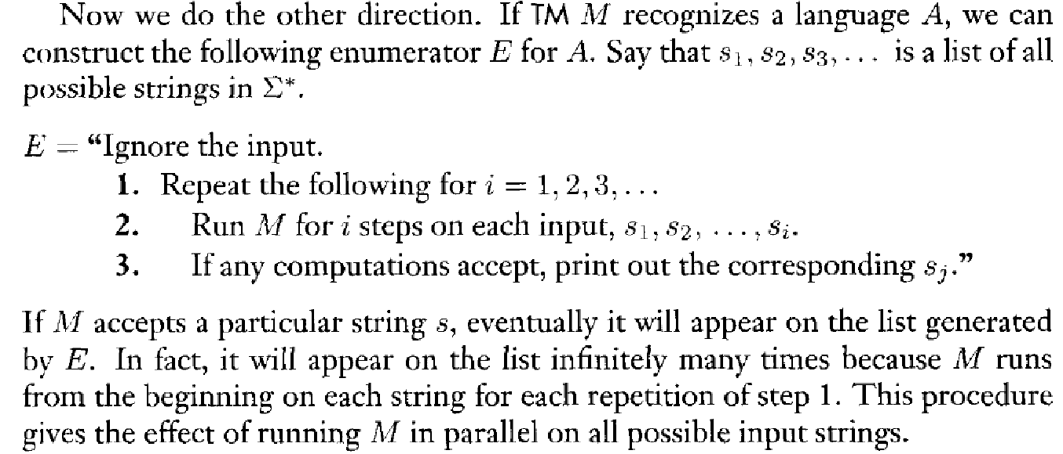
Equivalence

Slide 6


Classical Theory
Algorithm
Decidability
Efficiency (P vs. NP)
Algorithm
Decidability
Efficiency (P vs. NP)
Algorithm
Decidability
Efficiency (P vs. NP)
decidable
inefficient
efficient

Slide 7
Hilbert’s Program
Hilbert’s program (from wikipedia)
Axiomatization of all mathematics
Completeness: all true mathematical statements can be proved in the formalism
Consistency: no contradiction can be obtained in the formalism of mathematics
Decidability: there should be an algorithm for deciding the truth or falsity of any mathematical statement
“We must know. We will know”.

Slide 8
Encoding and decoding objects
0->1,R
0 -> 0,R
1 ->1,R
q0
1->0,R
q1
0->0,L
1 ->1,L
B->B,R
q2
q2
<O> is the encoding of objects, which is a string.

Slide 9
Language of TM
A Turing machine M accepts a string w if a sequence of configurations C1, C2, …..,Ck exist such that
C1 is the start configuration of M on w;
Each Ci yields Ci+1 and
Ck is the accepting configuration
L(M)={w|M accepts w}

Slide 10
Decidable
When we start a TM on an input w, three outcomes are possible: accept, reject or loop.
A TM is called a decider if it halts (accepts or rejects) on all inputs. A language is decided by a TM M if it is recognized by M.
A language is Turing-decidable or simply decidable if some TM decides it.

Slide 11
Acceptance problem for DFAs
The acceptance problem for DFAs of testing whether a particular DFA accepts a given string can be expressed as a language of strings:
ADFA={<B,w>: B is a DFA that accepts w}
Showing that the language is decidable is equivalent to showing that the acceptance problem is decidable.

Slide 12
Acceptance problem for DFAs
The acceptance problem for DFAs is decidable
Proof idea: Construct a TM
M=“on input <B,w>,where B is a DFA and w is a string,
1. Simulate B on input w.
2. In the simulation ends in an accept state, accept. If it ends in a nonaccepting state, reject. ”
Note that such defined TM is indeed a decider.

Slide 13
Acceptance problem for NFAs
Similarly define ANFA={<B, w>:B is an NFA that accepts w}. It is decidable.
Proof idea: Construct a TM
N=“on input <B,w> where B is an NFA and w is string:
1. Convert NFA B into an equivalent DFA C.
2. Run the above TM M on <C,w>.
3. If M accepts w, accept; otherwise, reject”
N is indeed a decider.
subroutine
Similarly AREX={<R,w>:R is a regular expression that generates w}
is decidable.

Slide 14
Emptiness testing problem for DFAs
Let
EDFA={<A>:A is a DFA and L(A)=0}
EDFA is decidable.
Proof idea: Construct a TM
T=“on input <A> where A is a DFA:
1. Mark the start state of A,
2. Repeat until no new states get marked:
3. Mark any state has a transition coming into it from any marked state.
4. If no accept state is marked, accept; otherwise, reject.”
Reachability analysis
Why is T a decider?

Slide 15
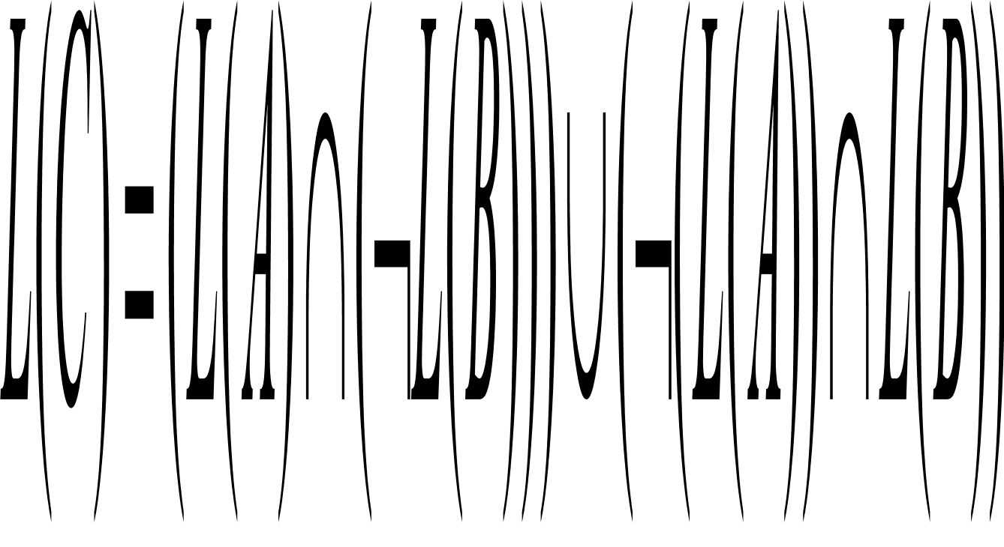
Equivalence problem for DFAs
Let EQDFA={<A,B>: A and B are DFAs and L(A)=L(B)}. This language is decidable.
Proof Idea: Define a DFA C such that
F=“On input <A,B>, where A and B are DFAs
1. Construct a DFA C
2. Run the above T on <C> subroutine
3. If T accepts, accept. If T rejects, reject.”
Any other algorithms?

Slide 16
Acceptance problem for CFG
The acceptance problem for CFG is decidable, i.e. ACFG={<G, w>:G is a CFG that generates w} is a decidable language.
Proof idea: Construct a TM S
S=“On input <G, w> where G is a CFG and w is a string:
1. Convert it into a Chomsky normal form.
2. List all derivations with 2n-1 steps, where n is the length of w.
3. If any of these derivations generate w, accept; otherwise, reject.”
Small model theorem: If G is a CFG in Chomsky normal form, then,
for any string w in L(G) of length n, exactly 2n-1 steps are required
for any derivation of w

Slide 17
Emptiness testing problem for CFGs
Let ECFG={<G>: G is a CFG and L(G)=0}. This language is decidable.
Proof idea: Construct a TM R
R=“on input <G>, where G is a CFG:
1. Mark all terminal symbols in G.
2. Repeat until no new variables get marked.
3. Mark an variable A where G has a rule A U1…Uk and each symbol U1, U2, …Uk has already been marked.
4. If the start symbol is not marked, accept; otherwise, reject.”
Why is R a decider?
However, the equivalence problem of testing whether two CFGS
are equivalent is not decidable.

Slide 18
Every CFL is decidable
Proof idea: Let A be a CFL and G a CFG for A.
MG=“On input w:
1. Run the above TM S on<G,w>.
2. If S accepts, accept; if it rejects, reject.”
Why not reason as follows:
Every PDA is a TM
Each PDA halts (?) on all inputs.

Slide 19
PDA: an extension of FA (in what sense)
Finite
State Control
a a a a
input
FA
PDA
X
y
z
Stack: “ last in,first out”
Infinite memory
Any PDA can be simulated by a TM with two tapes.

Slide 20
Where are we now?
Regular CFL
Regular CFL decidable Turing-recognizable
Why is the decider not regarded as a model of a general purpose computer?

Slide 21
Acceptance testing problem for TM
Let ATM={<M,w>: M is a TM that accepts w}. This language is Turing recognizable.
Proof idea: Construct a TM
U=“on input <M,w>, where M is a TM and w is a string:
1.Simulate M on w.
2. If M even enters its acceptance state, accept; if M ever enter its reject state, reject” (if M ever loops?)
Note that U is not necessarily a decider.

Slide 22
U is a universal Turing machine (Turing 1936)
program
<M>
string w
w
input
A particular
purpose TM
Universal TM
output
output
U can simulate any TM.
Can U simulate itself?

Slide 23
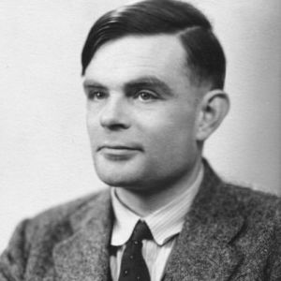
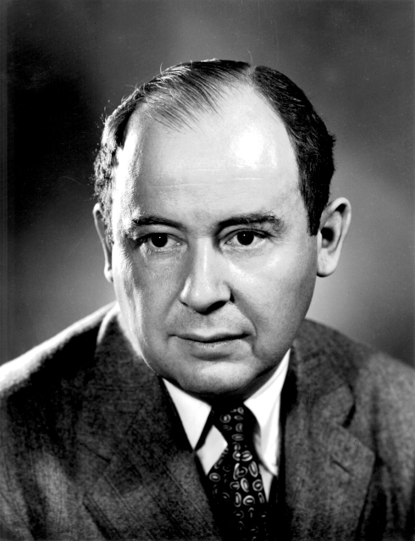
Turing met von Neumann
ACM Turing Award
IEEE von Neumann Prize

Slide 24
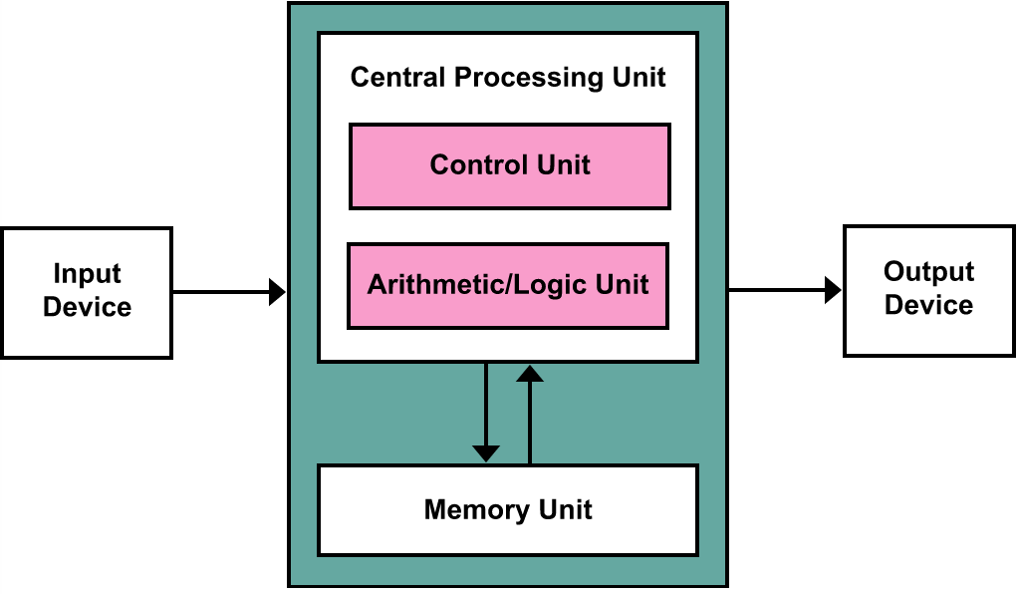
von Neumann architecture
把程序本身当作数据来对待，程序和该程序处理的数据用同样的方式储存。
冯·诺依曼和同事们依据此原理设计出了一个完整的现代计算机雏形，
并确定了存储程序计算机的五大组成部分和基本工作方法。冯·诺依曼的这一设计思想
被誉为计算机发展史上的里程碑，标志着计算机时代的真正开始。

Slide 25
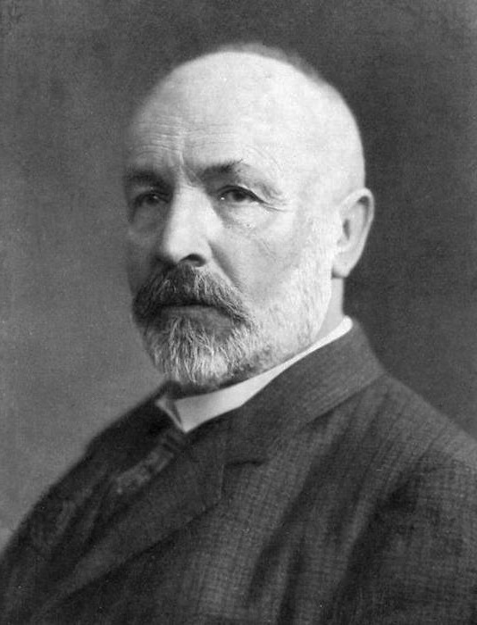
Diagonalization method
A set A is countable if either it is finite or it has the same size as N.
There is a correspondence (one-to-one and onto function) between the set N of natural numbers and the set Q of rationals.
The set R of real numbers is uncountable.
G. Cantor
(1845-1918)

Slide 26
An existence proof
There are some languages that are not Turing recognizable.
Proof idea:
the set of languages is uncountable
The set of Turing machines is countable.

Slide 27
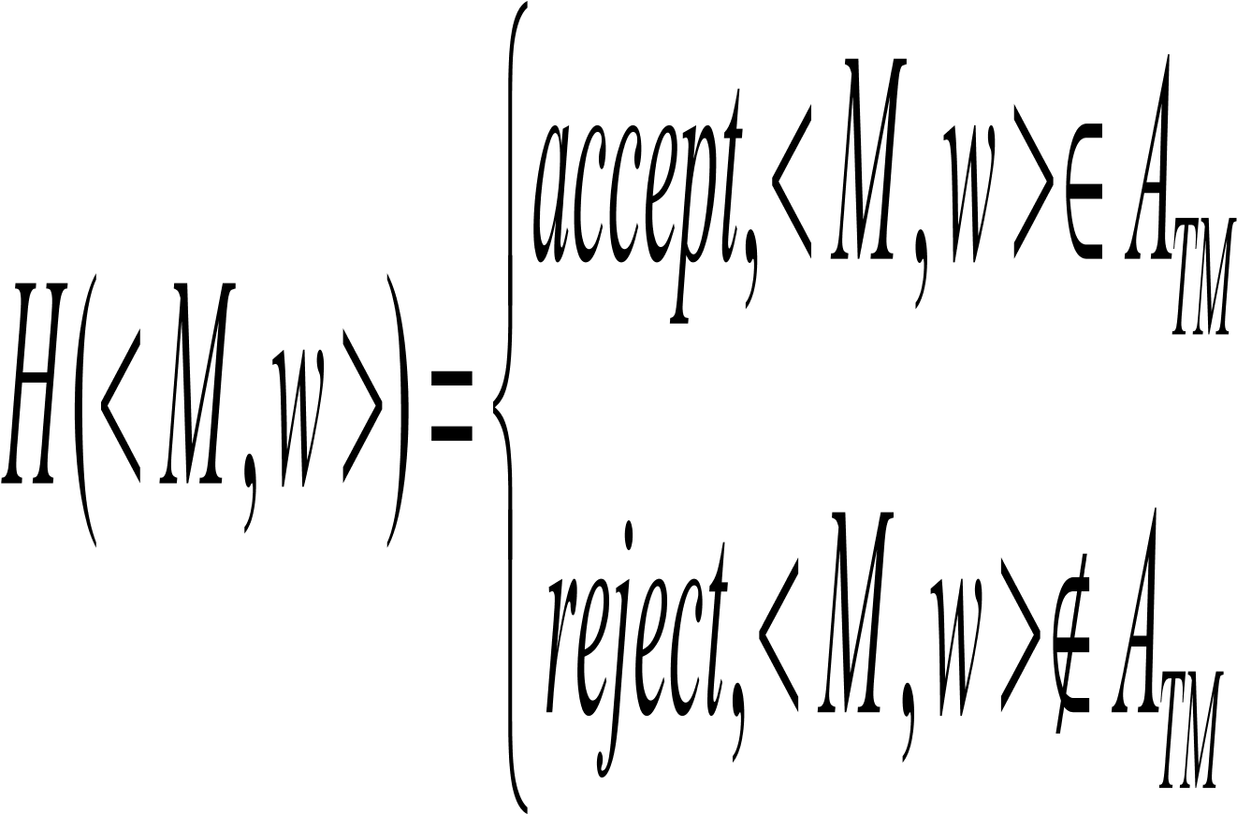
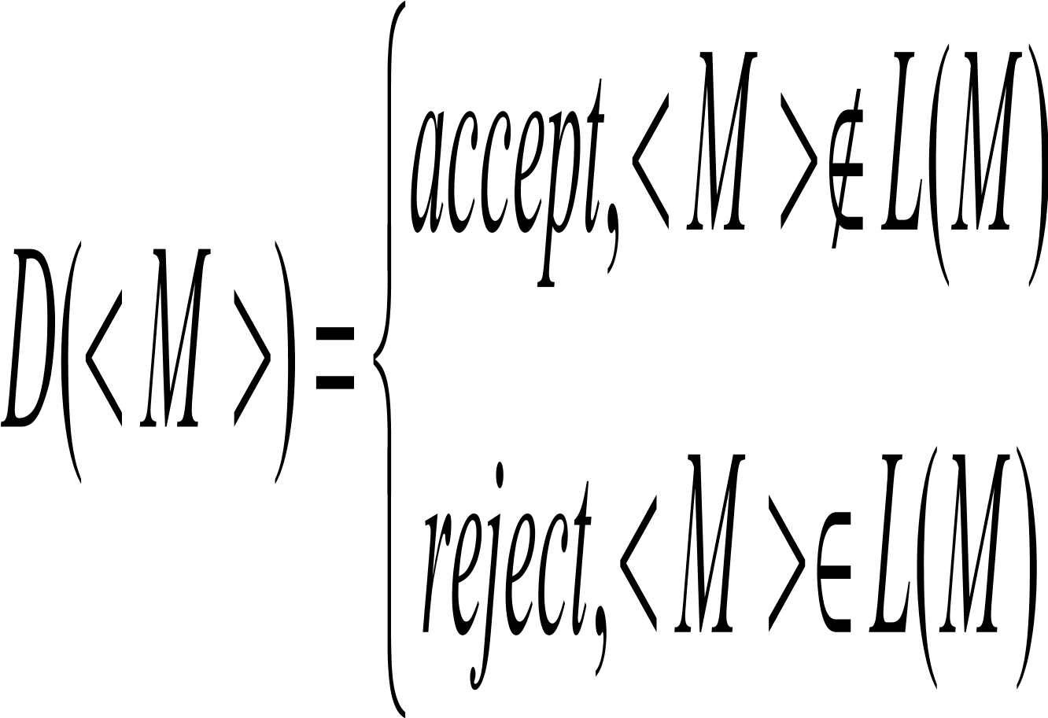
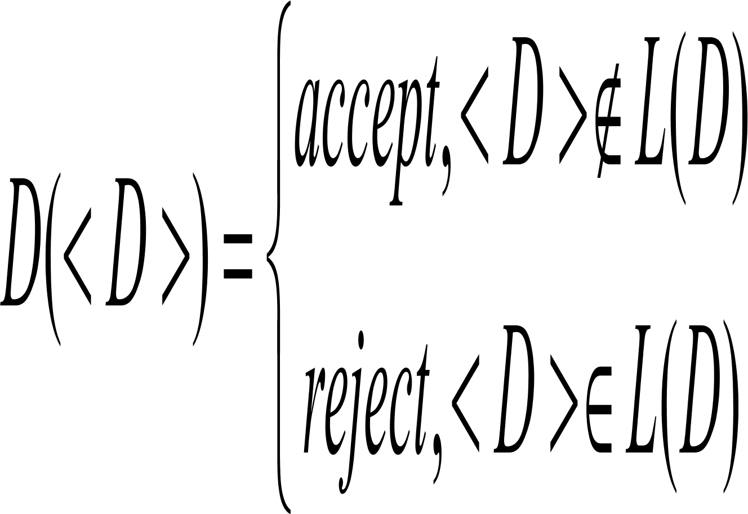
The universal language is not decidable (Turing 1936)
ATM is not decidable, i.e. U is not a decider.
Proof idea: Suppose that it is decided by a TM H.
From H, construct another TM
Difference!!
Is D a decider?
Contradiction

Slide 28
Turing-unrecognizable language
A language is co-Turing recognizable if its complement is Turing recognizable.
A language is decidable iff it is both Turing recognizable and co-Turing-recognizable.
The complement of ATM is not Turing –recognizable.

Slide 29
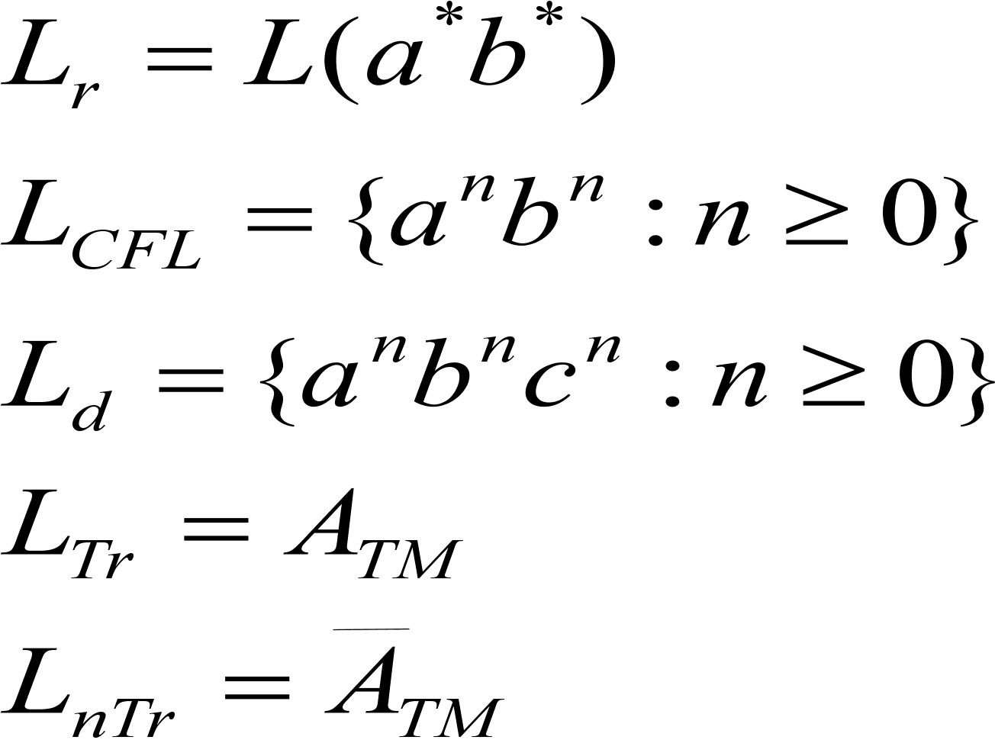
Where are we now?
Regular CFL
Regular CFL decidable Turing-recognizable
Why is the decider not regarded as a model of a general purpose computer?

